Slide 1
ClotheStation
E-Commerce
Collaborative Project by:
Carlos, Fabian, Abe, Chris, and Sam
Group1

Slide 2
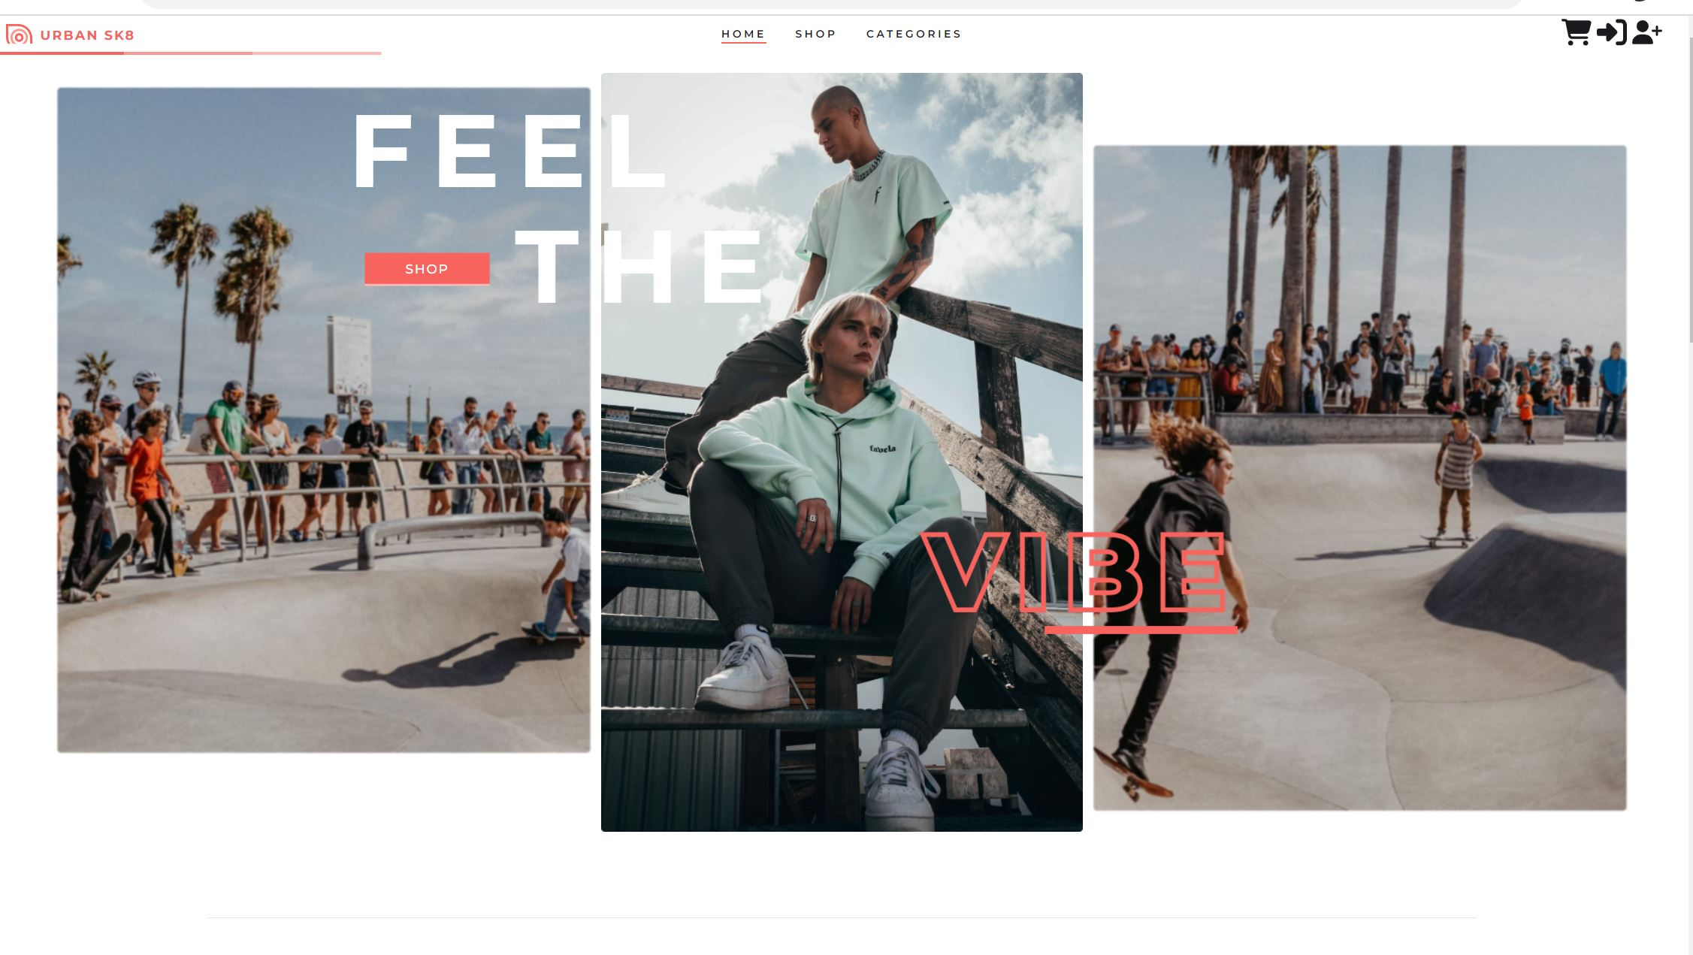

Slide 3
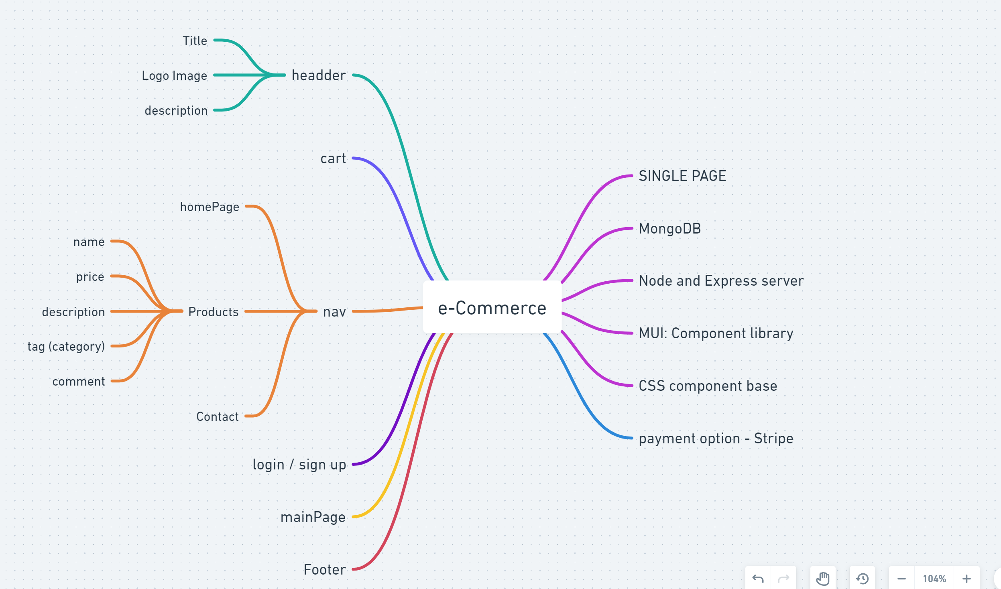
Initial Plan – mind mapping with Whimsical

Slide 4
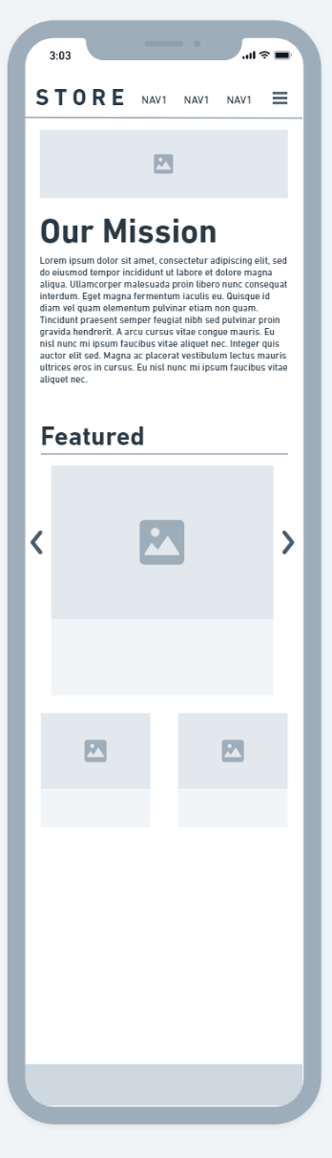
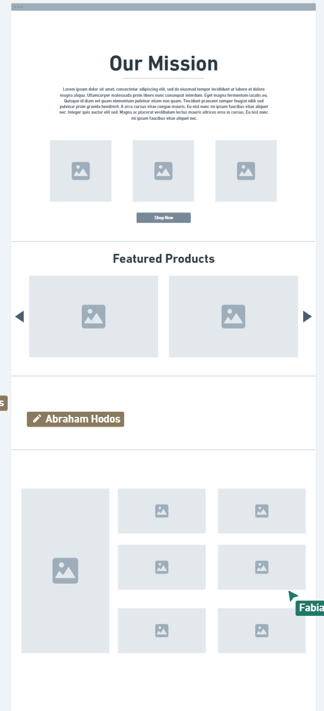
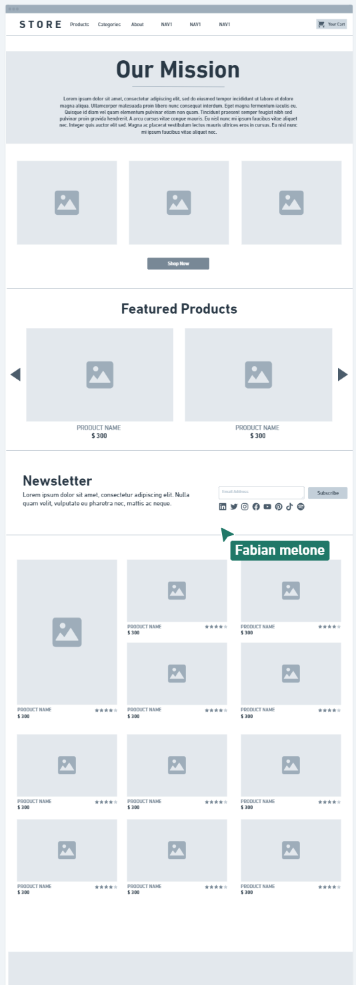
Initial Wire-Frames

Slide 5
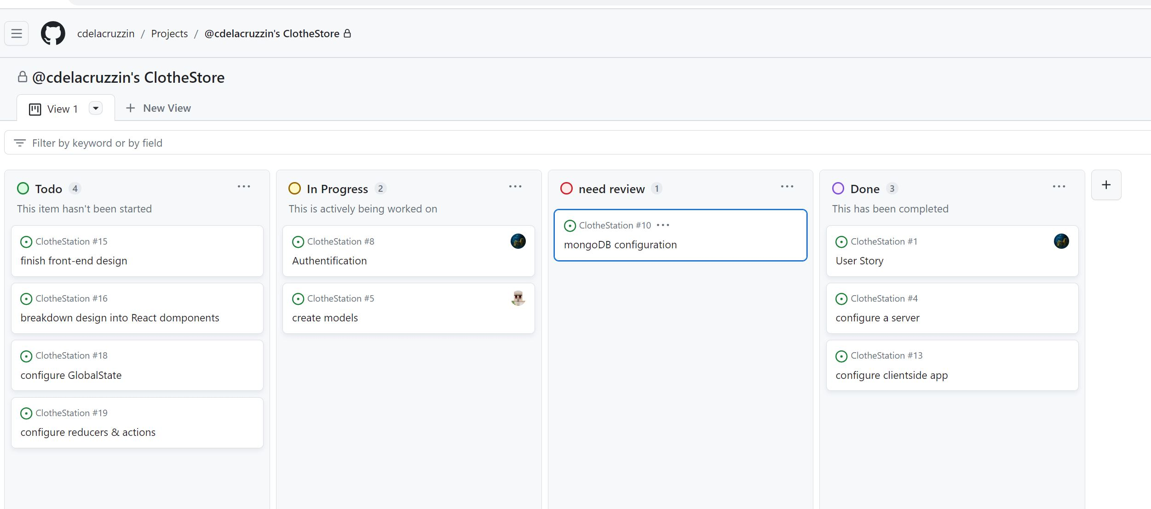
Kanban at the start

Slide 6
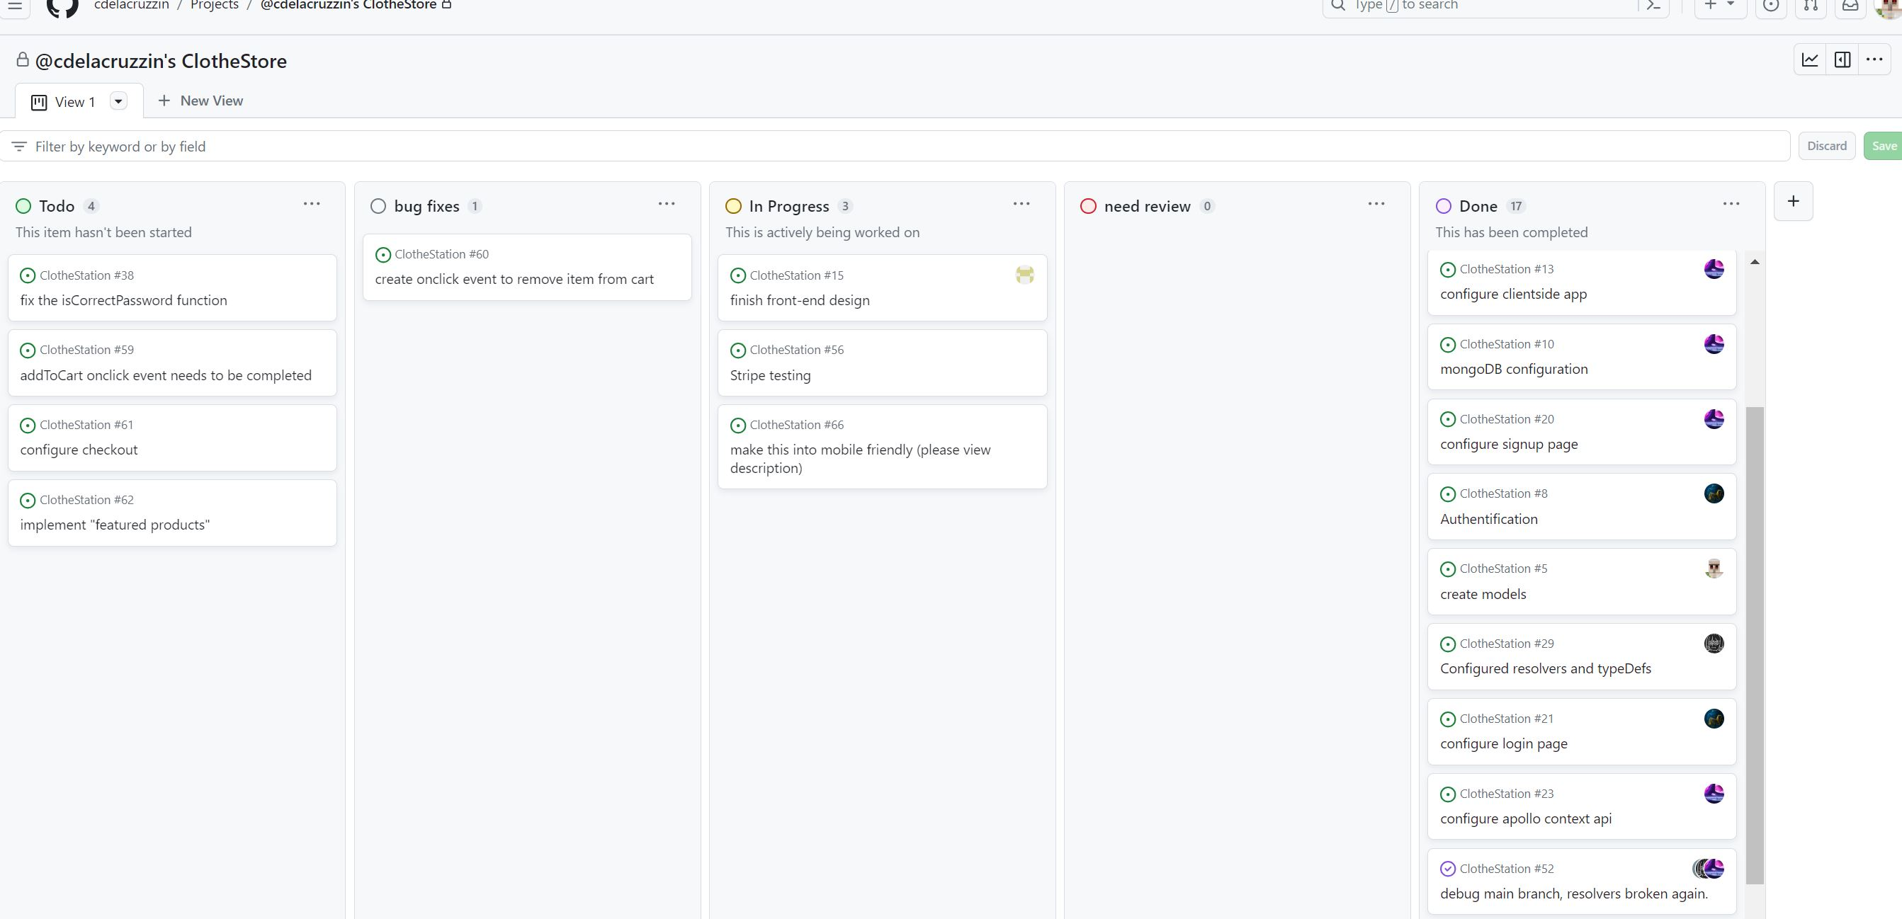
Kanban at finish

Slide 7
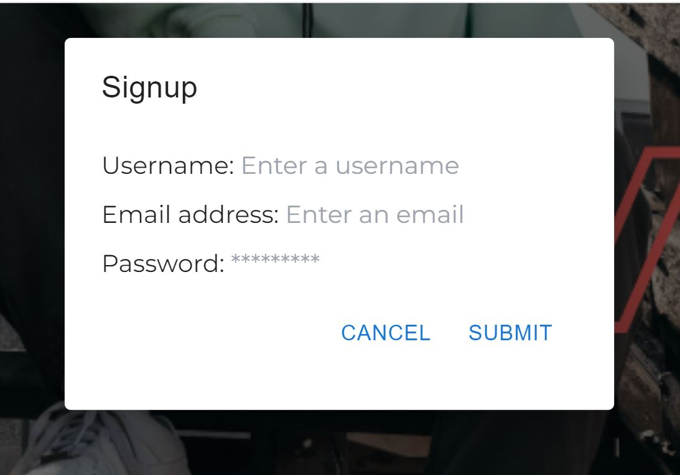
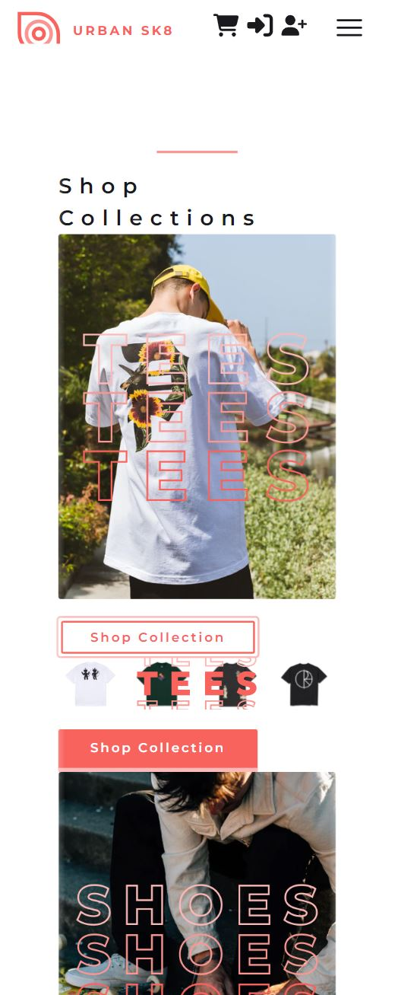
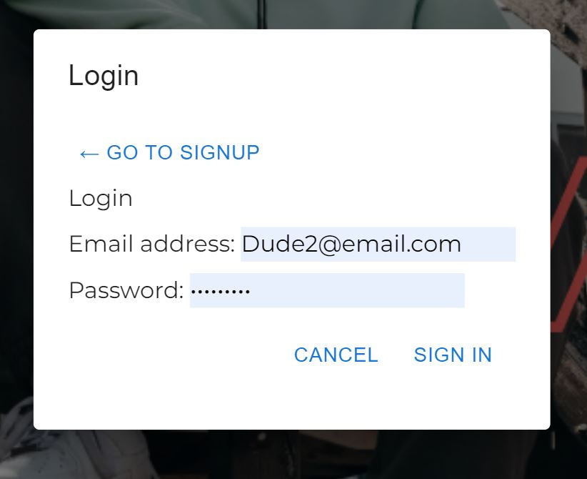
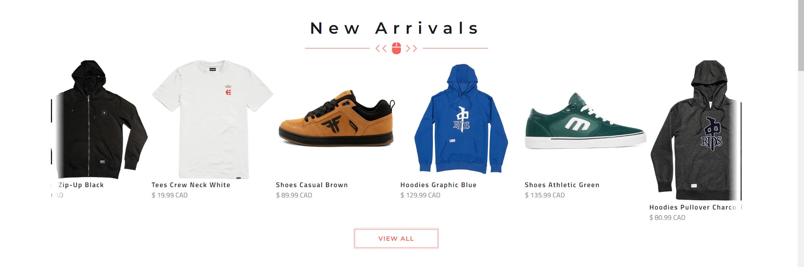
Our App

Slide 8
Our Challenges
Along the way of coding and developing the app, we face the following challenges, and this is how we overcame them:
…
<add your note here (pick one or two main challenges to talk about)>

